Slide 1
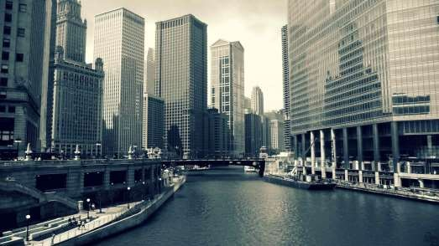
LECTURE # 01
INTRODUCTION TO URBAN DESIGN

Slide 2
Introduction
Urban design is the design of towns and cities, streets and spaces. It is the collaborative and multi-disciplinary process of shaping the physical setting for life in cities, towns and villages; the art of making places; design in an urban context.
That part of town planning or architecture that determines the order and form of the city with special emphasis on aesthetics (Frederick Gutheim, 1963).
Peter Webber defines urban design as 'the process of moulding the form of the city through time'.
Jerry Spencer has described it as 'creating the theatre of public life'.

Slide 3
Conti…
Organization of space, time, and communication/meaning (Amos Rapoport, 1977).
  Organization of space – for different purposes and according to different rules that reflect the needs, values, and desires of the groups or individuals
  Organization of Time – tempos and rhythms of human activity ,past versus future ,or linear versus cyclic;
  Organization of communication – a way of controlling interaction including:
    Its nature, direction, rate, etc
    Who communicates with who, when, where, and How?
    How the built environment and social organization are linked and related?
  Organization of meaning – communicative and symbolic properties of space through signs, materials, colours, forms, landscaping etc.

Slide 4
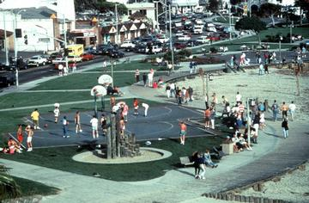
Thus, urban design is BOTH a means and an end-state! ……
Conti…
Urban design creates a framework for our lives. Design brings order and relation into human surroundings. It is the production of cities by people for people.

Slide 5
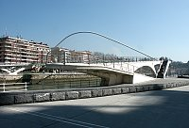
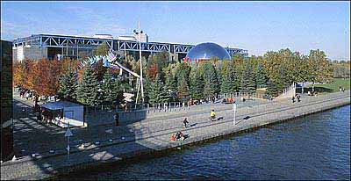
Interdisciplinary nature of urban design
Urban Design integrates the processes and expertise of many related disciplines including art, architecture, landscaping, the social sciences, economics, planning, engineering, and transport.
Notwithstanding, successful designs are actually determined by the public at-large rather than academia!.
Urban design works originates from engineering, architectural studies, and landscape science.

Slide 6
Urban Planning - Urban Design - Architecture Axis
The relationship is historical:
In the 1960s, planning and architecture were split (Gosling & maitland, 1984).
Planning concentrated on land use patterns and socio-economic issues (macro).
Architecture concentrated on the design of buildings (micro).
There emerged a responsibility gap where design of public space was concerned.
Urban design came in to bridge this gap.

Slide 7
Objectives of Urban Design
There is often considerable overlap between objectives and they are mutually re-enforcing; they include:
  Aesthetics: Strong Visual Impact
  Development: New Investment. Employment opportunities
  Functional Efficiency
  Improved Environmental conditions
  Safety (ref. Safer Cities Program; CEPTED)
  Guardianship and Space standards
  Technical Solutions to unique problems

Slide 8
Why is Urban Design Needed?
Design can help enhance a city’s advantages – physical needs of citizens; safety, security and protection; an environment free of pollution, noise, accidents, and crime; a conducive social environment ..a sense of community; an appropriate image and prestige; creativity and self-expression in neighbourhoods; aesthetically pleasantness as a place of culture and a work of art.
Design can help diminish a city’s disadvantages – containment of size & population; the obligation to travel; social stratification

Slide 9
Rationale for Urban Design
Any part of the city has a form and the assemblage of such parts generates a unique urban form and structure
Any part of a city is designable, and so is the assemblage of these parts to form streets, squares, urban fabric, monuments, skylines etc.
Even the incremental town forms evolve on the basis of commonly understood and accepted patterns…urban design offers a framework.
Today, many non-local forces are shaping the city; thus rules and patterns need to be introduced in the form of development and design frameworks founded on a city’s particular history, culture, location, etc. so as to safeguard its identity.

Slide 10
Criteria for Urban Design:
What may dictate an urban design undertaking?
Appeal (…how places look….)
Function …(how places work…);
Quality of urban areas; (ambience)
Community well-being: Vitality; safety;

Slide 11
Criteria for Urban Design:
What may dictate an urban design undertaking?
Environmental stress
Behavioural support
Identity
Diversity
Legibility
Meaning/communication
Development
Regeneration
Constraints

Slide 12
Abilities & Activities of Urban Designers
Analysis – An audit of the characteristics of a site to give a sense of place.
Collaboration – the need for urban designers to work with others, including with local communities.
Policy Formulation – required to deal with the breadth of urban design issues and activities.
Design Generation – Building, landscape and engineering design, site planning, master planning, framework design, illustrative design, and visioning.
Implementation – attention to how plans and proposals could be implemented requires a capacity for initiative, innovation, creativity, negotiation, collaboration, and management.

Slide 13
Typical Urban Design Problems/Issues
Area policy
New Settlements
Rehabilitation, redevelopment, and conservation
Lines of movement
Commercial centres and central districts
Special Areas
Large natural and man-made features

Slide 14
Definitive Principles of Urban Design
Urban design as political statement
Urban design as technique
Urban design as mediation
Urban design as private display
Urban design as public presence
Urban design as theatre
Urban design as guardian of urban standards

Slide 15
Link Between Urban Design and Site Planning
Urban design will enable the systematic identification and definition of sites.
Urban design will enable the informed and clear identification and/or selection of wider priorities about the site.
Urban design will enable good interpretation and use of existing features and operational forces.

